Slide 1
Grader Comments

Slide 2

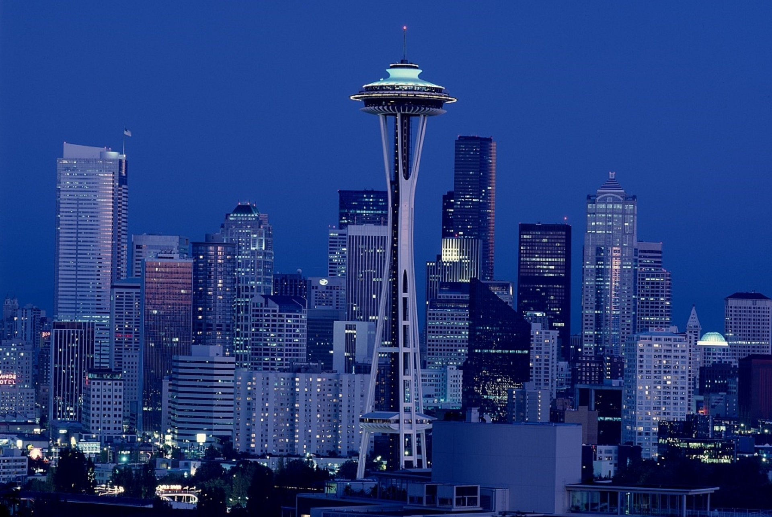


Airbnb's Price Predictions in Kirkland Seattle
Mike Olsen, Evan Kale, Kaleb Huyser, Mark Horcher

Slide 3
Executive Summary
Problem
What are the factors that affect an Airbnb price in Kirkland, Seattle? We believe that the knowledge in this study is beneficial to people looking to invest in Airbnb listings in Kirkland or maybe even wanting to stay there..
Measures
Variable Data, p-values of variables, multicollinearity/correlation
Methods
Multilinear Regression Model, Collinearity, Residual Plots
Data Sources
Conclusions
We gathered our data from Seattle Airbnb 2018 listings on Kaggle.com
We found that number of bathrooms had the biggest impact, while accommodations had the smallest impact on Airbnb pricing in Kirkland Seattle

Slide 4

Problem Statement
Which Airbnb factors have a significant impact on the price per night of an Airbnb in Kirkland, WA on December 19th, 2018?
Which factor has the greatest impact on the price per night of an Airbnb in Kirkland, WA?
Which factor has the least impact on the price per night of an Airbnb in Kirkland, WA?

Slide 5
Problem Statement
Independent Variables
Number of bedrooms
Dependent Variables
Price per night of the Airbnb in Kirkland, WA on December 19th, 2018
Number of bathrooms
Amount of reviews
Strategy
Develop a multi-variable regression model to approximate Airbnb pricing in Kirkland, WA on December 19th, 2018
Amount of accommodations

Slide 6
Data
Kaggle
Data scrapped on December 19th, 2018, and contains roughly 8000 listings of current Airbnb listings in Seattle
Content
Price, reviews, latitude, longitude, bedrooms, bathrooms, number of guests it accommodates, room type, and more
Limitations
Prices of listings can increase throughout the year
Listings can be left without a review

Slide 7
Methodology
Data Preparation
Narrowed down our focus to only listings in Kirkland, WA
Filtered out Airbnb's that were only listed with private rooms available
Kept Airbnb listings with both entire home and entire apartment room types
Independent Variables | Dependent Variable
Reviews, accommodates, bedrooms, bathrooms | Overall price with respect to listing incentives

Slide 8
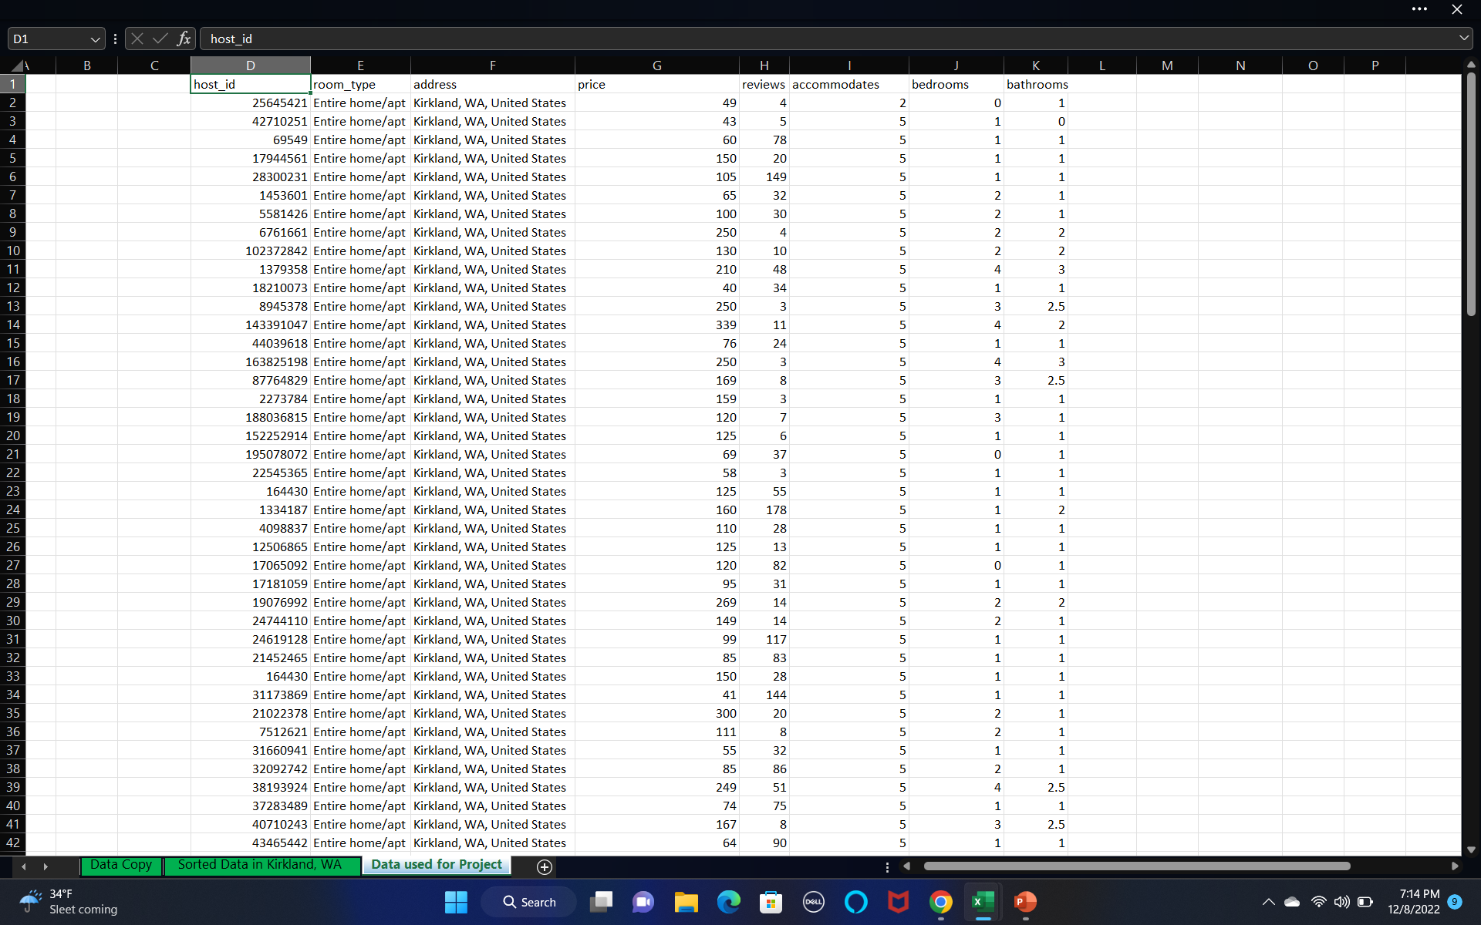
Notes:
this is a visual aid to represent the previous slide, our data preporation. However, it is to be noted that in this photo only 42 of our 132 rows are pictured. Additionally, it is easy to see that both our independent variables of reviews, accomoates, bedrooms and bathrooms are listed, as well as or dependendent varible of price.

Slide 9
Collinearity
 | reviews | bathrooms | bedrooms | accommodates
reviews | 1
bathrooms | -0.124995252 | 1
bedrooms | -0.156538708 | 0.748239855 | 1
accommodates | 0.056750946 | 0.060930196 | 0.147327579 | 1

Slide 10
Data Set
Host ID | Room Type | Address | Price | Bathrooms
25645421 | Entire home/apt | Kirkland, WA, United States | 49 | 1
42710251 | Entire home/apt | Kirkland, WA, United States | 43 | 0
69549 | Entire home/apt | Kirkland, WA, United States | 60 | 1
17944561 | Entire home/apt | Kirkland, WA, United States | 150 | 1
28300231 | Entire home/apt | Kirkland, WA, United States | 105 | 1
1453601 | Entire home/apt | Kirkland, WA, United States | 65 | 1
5581426 | Entire home/apt | Kirkland, WA, United States | 100 | 1
6761661 | Entire home/apt | Kirkland, WA, United States | 250 | 2
102372842 | Entire home/apt | Kirkland, WA, United States | 130 | 2
1379358 | Entire home/apt | Kirkland, WA, United States | 210 | 3

Slide 11
Regression
SUMMARY OUTPUT
Regression Statistics
Multiple R | 0.434148794
R Square | 0.188485175
Adjusted R Square | 0.182242753
Standard Error | 222.7569862
Observations | 132
ANOVA
 | df | SS | MS | F | Significance F
Regression | 1 | 1498258.527 | 1498258.527 | 30.1942392 | 1.98421E-07
Residual | 130 | 6450687.738 | 49620.67491
Total | 131 | 7948946.265
 | Coefficients | Standard Error | t Stat | P-value | Lower 95% | Upper 95% | Lower 95.0% | Upper 95.0%
Intercept | -73.66890182 | 46.53903944 | -1.582948482 | 0.11586303 | -165.7408255 | 18.40302189 | -165.7408255 | 18.40302189
bathrooms | 158.1819332 | 28.78689563 | 5.494928498 | 1.98421E-07 | 101.2305029 | 215.1333635 | 101.2305029 | 215.1333635

Slide 12
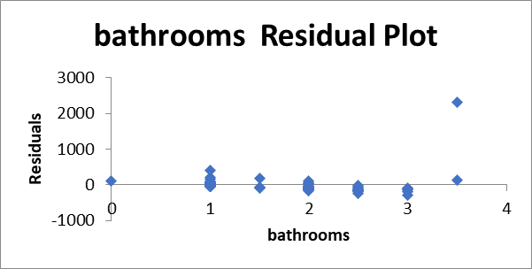
Residual Pot

Slide 13
Final Model
Price per night of an Airbnb in Kirkland, WA
= -73.67 + 158.18*(A)
A = Bathrooms

Slide 14
Conclusion
The parsimonious model includes only the bathrooms factor
The bathroom factor is the only significant variable with a p-value of 1.98421E-07
Bedrooms had the lowest R squared compared to bathrooms and was removed.
The reviews, and accommodates are not significant variables with p-values in the same order (.29, .82)

Slide 15
Works Cited
Levine, S. (2018, December 20). Seattle Airbnb listings. Kaggle. Retrieved December 9, 2022, from https://www.kaggle.com/datasets/shanelev/seattle-airbnb-listings

